Slide 1
COMP 4290
Week 16 - Wednesday

Slide 2
Last time
What did we talk about last time?
Review of the first half of the course

Slide 3
Questions?

Slide 4
Reveal Secret Messages!

Slide 5
Review

Slide 6
Privacy Concepts

Slide 7
What is information privacy?
Controlled disclosure
  Right to control who knows your private data
  Control is always diminished by sharing data with another party
Sensitive data
  Not all data is equally sensitive
  Different people in different circumstances may disagree about what should be protected
Affected subject
  Both people and businesses have private data
  Increasing privacy (an aspect of confidentiality) often decreases availability

Slide 8
Computer-related privacy problems
Broad data collection
No informed consent
Loss of control
Ownership of the data

Slide 9
Fair information policies
In 1973, a committee advising the U.S. Department of Human Services proposed a set of principles for fair information practice:
  Collection limitation
  Data quality
  Purpose specification
  Use limitation
  Security safeguards
  Openness
  Individual participation
  Accountability

Slide 10
U.S. privacy laws
The 1974 Privacy Act is a broad law that covers all the data collected by the government
  The law is based on the principles from the previous slide
Laws for data collected by other organizations are for specific areas and not necessarily consistent
  Fair Credit Reporting Act is for consumer credit
  Health Insurance Portability and Accountability Act (HIPAA) is for healthcare information
  Gramm-Leach-Bliley Act (GLBA) is for financial services
  Children's Online Privacy Protection Act (COPPA) is for children's web access

Slide 11
Non-US privacy
The European Union adopted the European Privacy Directive that requires that data about individuals be:
  Processed fairly and lawfully
  Collected for specified, explicit, and legitimate purposes
  Adequate, relevant, and not excessive for the purposes they were collected
  Accurate and as up to date as necessary
  Kept in a form that permits identification of individuals for no longer than necessary

Slide 12
Authentication

Slide 13
Authentication
We have already discussed authentication from the perspective of how to do it
  But what are we really authenticating?
We could be authenticating any of the following three things:
  Individual
    The physical person
    Example: you
  Identity
    A string or numerical descriptor
    Examples: the name "Clarence", the account admin
  Attribute
    A characteristic
    Examples: being 21, having top secret clearance

Slide 14
Correlation in data mining
Correlation is joining databases on common fields
Privacy for correlation can be improved by making it harder to find links between related fields
Data perturbation randomly swaps fields in records
  Swapping records indiscriminately can destroy the value of the research
  It has to add just enough randomness to the right fields

Slide 15
Aggregation in data mining
Aggregation means reporting sums, medians, counts or other statistical measures
As we discussed in the database chapter, these can threaten privacy if we have a very small sample size
A corresponding problem happens if we have a sample that includes almost but not quite all of the data
For aggregates, data perturbation means adding small, random positive and negative values to each value, adding noise to the final aggregates
  If done correctly, the aggregates may still be accurate enough for research purposes

Slide 16
Privacy on the Web

Slide 17
Payment
Credit cards can easily be defrauded since you provide the critical information to stores
Payment schemes like Venmo and PayPal give more anonymity but do not have the same consumer protection laws

Slide 18
Site registration
Virtually every site on the Internet allows (if not requires) you to register with a user name and password so that you can log in
For the sake of privacy, you should have a different ID and password for every site
  This, of course, is impossible
People tend to use one or two IDs (and one or two passwords) for everything
  Many websites encourage this behavior by forcing you to use your e-mail address as your ID
In this way, it is easy for anyone with access to multiple databases to aggregate information about you
  Since your e-mail address is often tied closely to you, they could find out your true identity

Slide 19
Cookies
A cookie is a small text file kept on your computer that records data related to web browsing
Cookies can only be read by the site that originally stored the cookie
The way to get around this is called third-party cookies
  Networks of sites can form an alliance in which they cooperate to track all of your visits to sites in the network
Visiting a single page could store cookies from every ad on the page (and more!)
Web bugs are images that are usually 1 x 1 pixels and clear
  They make it impossible to know how many sites could be storing cookies

Slide 20
E-mail
Regular mail cannot be opened under penalty of federal law
Most people do not encrypt their e-mail using PGP or S/MIME
E-mail travels from originating computer to SMTP server through the Internet to a POP server to the destination
  Anyone can read and collect your e-mail on the way
E-mail provides almost no guarantee of authenticity

Slide 21
Privacy in emerging technologies
Radio frequency identification (RFID) tags are usually small, inexpensive transmitters
  They can be attached to almost anything
  The infrastructure to track you everywhere may soon exist
Electronic voting has many issues
  It's hard to engineer a system that correctly counts votes but cannot report how someone voted
  The software and hardware design for these systems are generally not publicized
  Internet voting will probably increase
VoIP
  Privacy is in the hands of Skype, Zoom, or Teams

Slide 22
Risk Management

Slide 23
Parts of a business continuity plan
A business continuity plan covers what will happen if a computer security problem actually happens
These plans cover big problems
  Catastrophic situations where large portions of the computer systems don't work
  They must stop working for a long duration
Assess business impact
Develop strategy to control impact
Develop and implement a plan

Slide 24
Incident security plans
An incident security plan covers the non-business parts of any security breaches
  There should be incident security plans even for incidents that are too small to fall under a business continuity plan
Such a plan covers:
  The definition of an incident
  Who is responsible for taking charge
  What the plan of action is
Such a plan must consider:
  Legal issues
  How to preserve evidence
  How to record the progress in executing the plan
  How to handle public relations

Slide 25
Risk terminology
Risk is the potential for a problem
Risk is characterized by three factors
  Loss associated with the event
    Risk impact
  Likelihood that the event will occur
    A likelihood of 1 means there is a problem
  The degree to which we can change the outcome
    Risk control is reducing the risk
Risk exposure = risk impact × risk probability
We can avoid, transfer, or assume the risk, depending on the tradeoffs

Slide 26
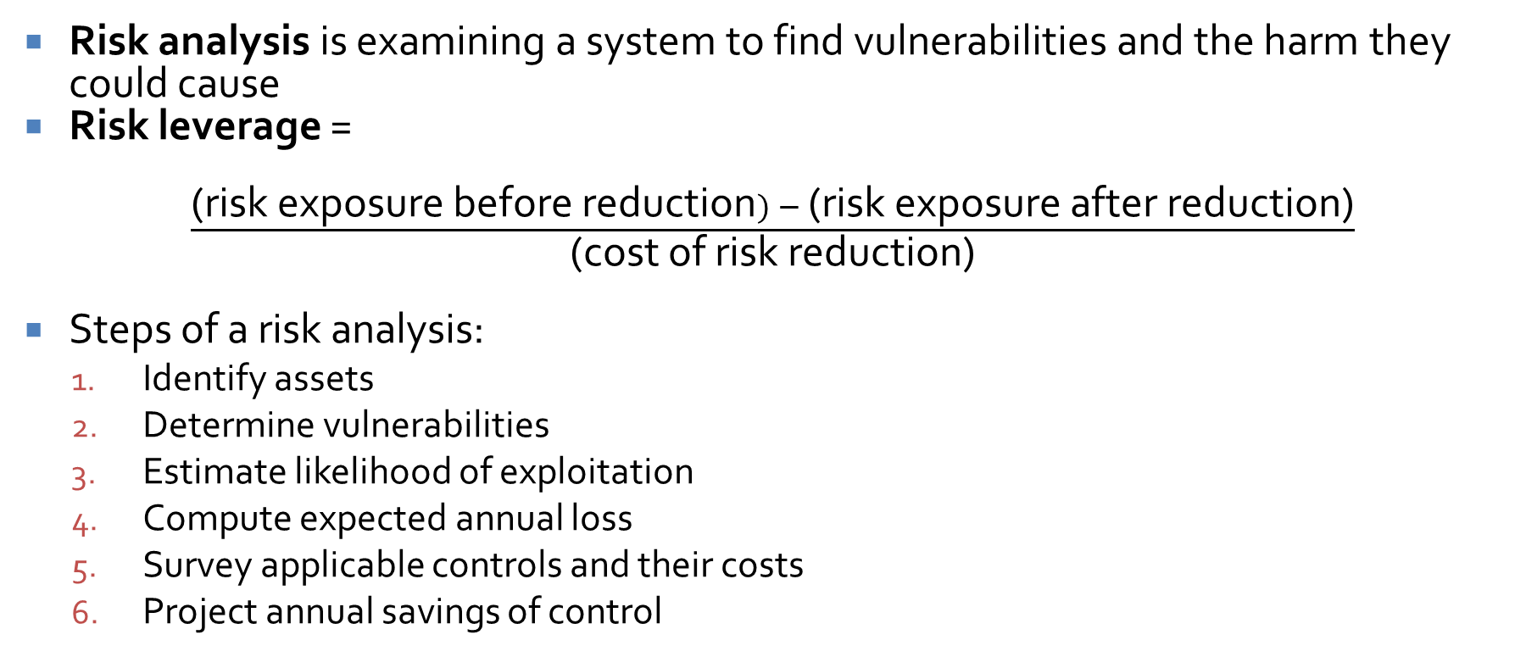
Risk analysis
Risk analysis is examining a system to find vulnerabilities and the harm they could cause
Risk leverage =
$\frac{\text{(}\text{risk} \text{exposure} \text{before} \text{reduction}) − \text{(}\text{risk} \text{exposure} \text{after} \text{reduction}\text{)}}{\text{(}\text{cost} \text{of} \text{risk} \text{reduction}\text{)}}$
Steps of a risk analysis:
  Identify assets
  Determine vulnerabilities
  Estimate likelihood of exploitation
  Compute expected annual loss
  Survey applicable controls and their costs
  Project annual savings of control

Slide 27
Risk analysis pros and cons
Pros | Cons
Improve awareness | False sense of confidence
Relate security mission to management objectives | Hard to perform
Identify assets, vulnerabilities, and controls | Done once and then forgotten
Improve basis for decisions | Lack of accuracy
Justify expenditures for security

Slide 28
Physical security
Natural disasters
  Flood
  Fire
  Everything else
    Insure and backup
Power issues
  Power loss
  Uninterruptible power supplies (UPS)
  Surge suppressor
Human vandals
  Unauthorized access
  Theft

Slide 29
Disposing of sensitive information
Shredding paper documents
Overwriting magnetic data
Degaussing
Van Eck phreaking safeguards

Slide 30
Backups
Everything should be backed up, always
A complete backup covers the current state of all data
Revolving backups keep the last few complete backups
A selective (or incremental) backup stores only the files that have changed since the last backup
Ideally, you should have an offsite backup of all your data in case of fire or flood
  Backing up your critical data on a USB or external HD and keep it at home or school or vice versa is a good idea for you guys

Slide 31
Legal and Ethical Issues

Slide 32
Copyrights, patents, and trade secrets
 | Copyright | Patent | Trade Secret
Protects | Expression of idea, not idea itself | Invention, the way something works | A secret, a competitive advantage
Protected object made public | Yes, all about promoting publication | Filed at patent office | No
Requirement to distribute | Yes | No | No
Ease of filing | Easy, do it yourself | Complicated, usually needs lawyers | No filing
Duration | Life of author + 70 years, 95 years for corporations | 19 years | As long as you can keep it secret
Legal protection | Sue if unauthorized copy sold | Sue if invention copied | Sue if secret improperly obtained

Slide 33
Criminal vs. civil law
 | Criminal Law | Civil Law
Defined by | Statutes | Contracts Common law
Cases brought by | Government | Government Individuals and companies
Wronged party | Society | Individuals and companies
Remedy | Jail or fine | Damages, usually money

Slide 34
Who owns what?
If you are paid to develop software, the company owns the software
If you write code in your free time, it is possible that your job can still claim a piece of it (especially if you used any of their hardware or software)
If you are a consultant who writes a program for a client and then further develop it yourself, it's complicated
Often covered by your contract

Slide 35
Patents and copyrights
The inventor is the entity that owns the patent
  Who is the inventor?
  It matters whether your employer files the patent or if you do
In general, when you create something, you hold the copyright
The exception is a work for hire situation which exists when some or all of the following apply:
  The employer has a supervisory relationship
  The employer has the right to fire you
  The employer arranges for the work to be done before it is created
  A written contract states that the employer has hired you to do certain work

Slide 36
Reporting flaws
Researchers and users should report flaws to companies so that they can be fixed, but there is disagreement about how public the reporting is
Developers want the vulnerabilities secret as long as possible so that a small number of patches can fix many vulnerabilities
Users want more pressure on developers to fix problems quickly
Researchers have suggested guidelines to reach a compromise between these two groups

Slide 37
Computer crime
Computer crime needs new definitions for crime
  Traditional crime focuses on crimes against people (murder) or crimes against objects (theft)
Copying software is not traditional theft because no tangible object is missing
Computer trespassing has a similar problem
Evidence of computer crime is difficult to authenticate

Slide 38
Computer criminals are hard to catch
Much of the crime is international, and there are no international computer laws
  Although many countries cooperate to catch criminals, there are safe havens where they cannot be arrested
Technical problems make them hard to catch
  Attacks can be bounced through many intermediaries, each requiring their own search warrant
  The right network administrators has to be given the warrant (and he or she might not keep good records)

Slide 39
Cryptography and the law
Many countries have controls on the use of cryptography
  Governments want cryptography they can break so that they can catch criminals
  Laws are hard to enforce for individuals, especially now that the instructions for coding up AES are widely available
Until 1998, export of cryptography in the US was covered under laws preventing the export of weapons of war
  This definition changed, although there are still export restrictions
  There were never any restrictions on the use of cryptography in the US
  Absurdly, the government said that object code was subject to export restriction, but printed source code was an idea and therefore not

Slide 40
Escrowed cryptography
The government made proposals to relax export rules for escrowed encryption
  With escrowed encryption, the government is given copies of all the keys used to protect all transmissions, but promises to use them only with court authorization
Three well known proposals for these systems were Clipper, Capstone, and Fortezza
These proposals were not adopted because of public distrust of what the government might do with all the keys

Slide 41
Laws vs. ethics
Laws:
  Apply to everyone
  Courts determine which law applies or if one supersedes another
  Laws and courts define what is right (legal) and what is wrong (illegal)
  Laws are enforced
Ethics:
  Are personal
  Ethical positions often come into conflict with each other
  There is no universal standard of right and wrong
  There is no systematic enforcement for ethical decisions

Slide 42
Examining an ethical choice
Understand the situation
  Learn all the facts about the situation first
Know several theories of ethical reasoning
  There may be many ways to justify different choices
List the ethical principles involved
  What different philosophies could be applied?
Determine which principles outweigh others
  This is the hard part where you have to make a subjective valuation

Slide 43
Ethical breakdown
 | Teleology (Consequence-based) | Deontology (Rule-based)
Individual | Based on consequences to the individual (egoism) | Based on rules acquired by the individual from religion, analysis, or experience
Universal | Based on consequences to society (utilitarianism) | Based on universal rules that everyone can agree on (but there are very few of these)

Slide 44
Upcoming

Slide 45
Next time…
There is no next time!

Slide 46
Reminders
Final exam:
  Wednesday, December 10, 2025
  12:30 – 2:30 p.m.
Finish Project 3
  Remember to document your attacks and explain your own system

